Slide 1



Numerical Simulation of Laramide Flat-Slab Subduction
Presentation by Samantha Jaide Winstin-Seitz: Collaboration with Thomas Hoisch and Sarah Petersen

Slide 2
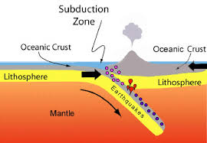
What is Subduction?
The oceanic crust and the lithosphere on the left side of the diagram are subducting underneath the oceanic crust and lithosphere on the right side of the diagram.
Tectonic plates and the density of the oceanic crust cause it to slide underneath the other plate and subduct down into the mantle.
This subduction of the plate down into the mantle creates magmatism that uplifts and can cause volcanism
“Discover Subduction Zones.” Discover Our Earth, Cornell University, NSF, Museum of the Earth. 2020

Slide 3
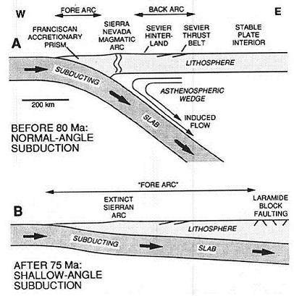
What is the Question we are trying to answer?
Flat slab subduction: what is the difference and what does it affect?
Dumitru et al., 1991

Slide 4
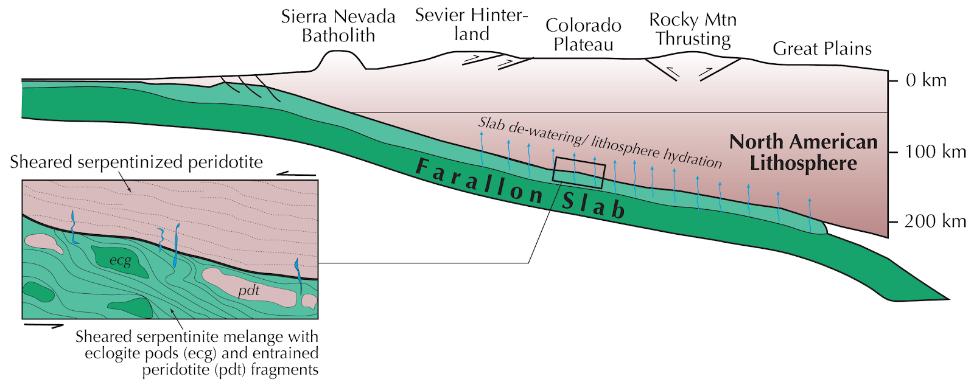
What does Flat-Slab Subduction affect?
Going further down a subduction zone allows for higher temperatures and water-fluxed melting
Provides a mechanism to explain the lack of volcanism above subduction zones
Flat-slab subduction causes cooling of the upper plate (English et al., 2003)
This difference in regular vs flat-slab subduction can provide a possible explanation for observed differences in characteristics of geologic features
Flat-slab subduction could be tied to Colorado Plateau uplift
Modified from Behr 2013 from Humphreys et al., 2003

Slide 5
The Goals
1) To create a realistic model that tests the theory of flat slab subduction magmatism at shallower depths in the lithosphere/asthenosphere. Explore the idea of crustal melting
Simulate subduction of the Laramide in California

Slide 6
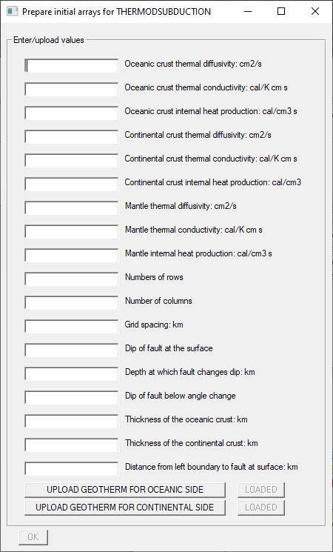
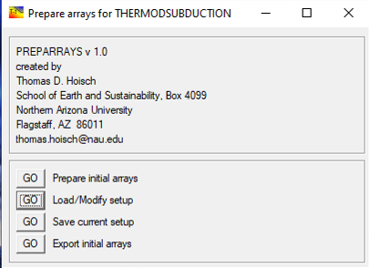
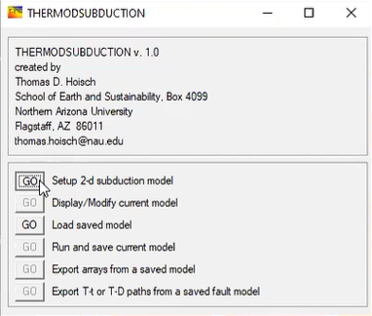
How Did we Answer the Question?
I used ThermodSubduct, Sublime, GMT, Irfanview, Adobe Illustrator, and GIMP to create models
In Thermodsubduct, I created thermal models of subduction zones (Laramide). The difference in temperature for a regular subduction zone vs a flat slab subduction zone control whether you have volcanism what minerals are stable

Slide 7
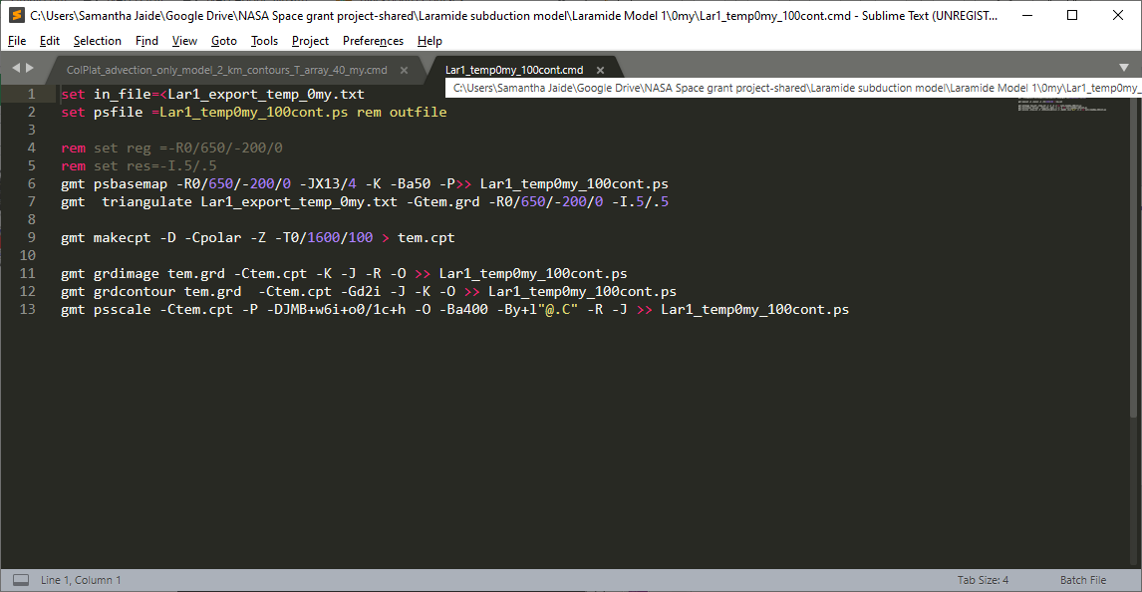
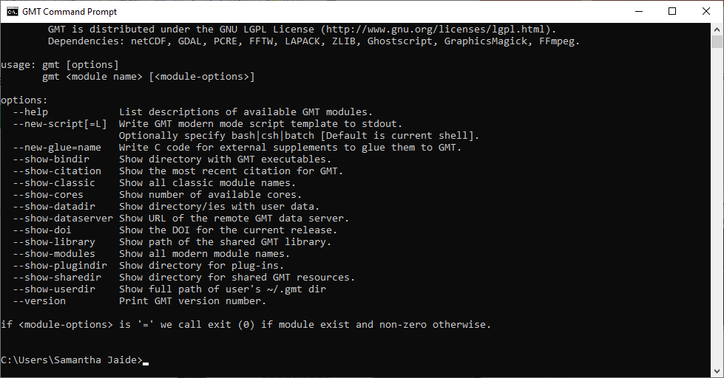
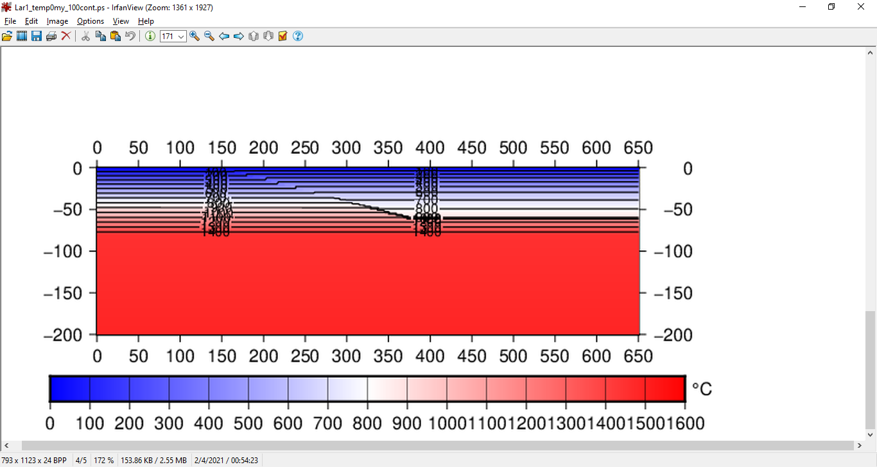

Slide 8
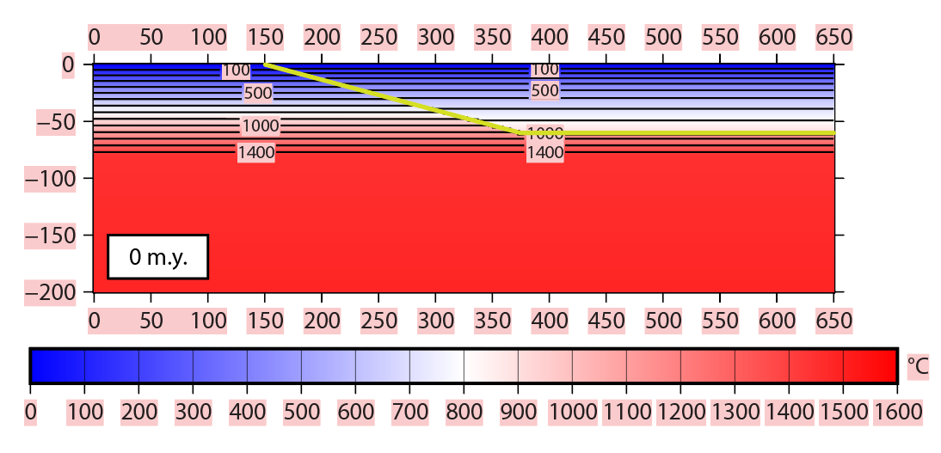
Initial Condition
  Theoretical geothermal gradients calculated for rocks above and below the fault
  Yellow line is the subduction fault

Slide 9
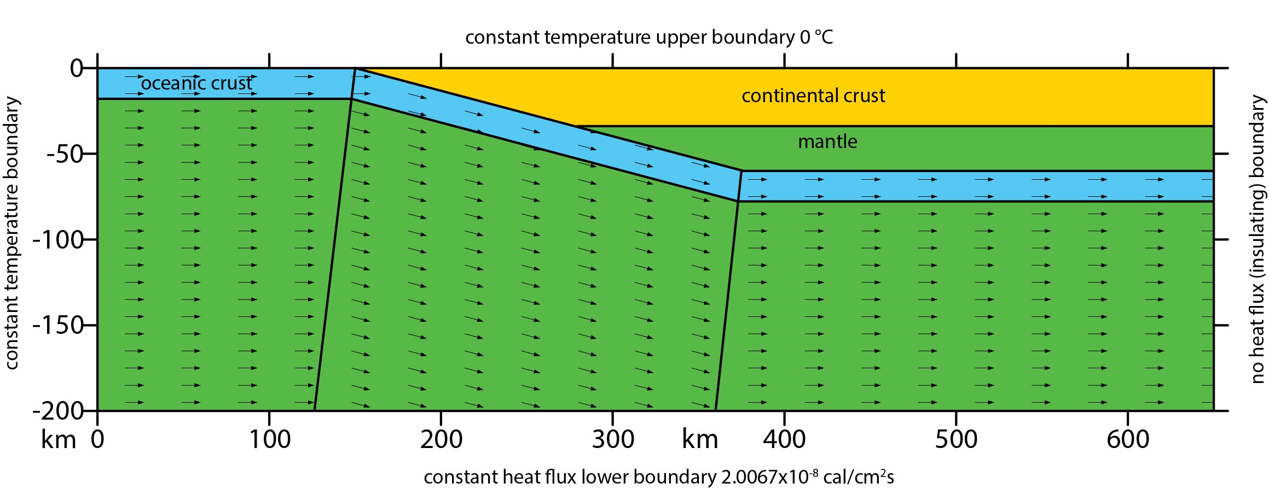
Model Setup with boundary conditions
Vector Diagram of direction and speed of tectonic plate at initial condition
Notice diagram boundary conditions
Tilted lines are vector domain boundaries
Need initial conditions as well as boundary conditions

Slide 10
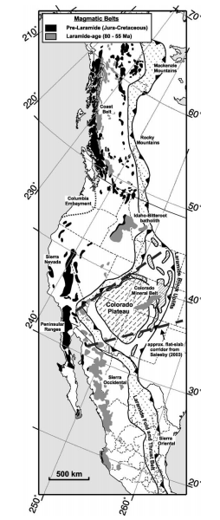
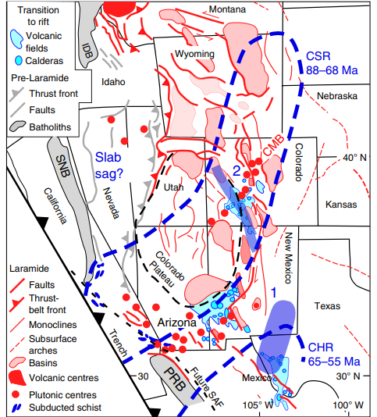
The Geology of the Laramide Subduction Zone, California
Cold flat-slab subduction produced by old oceanic plate. Slab remains hydrated until it penetrates the asthenosphere.
There is still normal subduction north and south of the Laramide
Magmatism shut off everywhere; can be attributed to the slab breaking off from the north and south, allowing shallow angle subduction
English et al. (2003)
Axen et al. (2018)

Slide 11
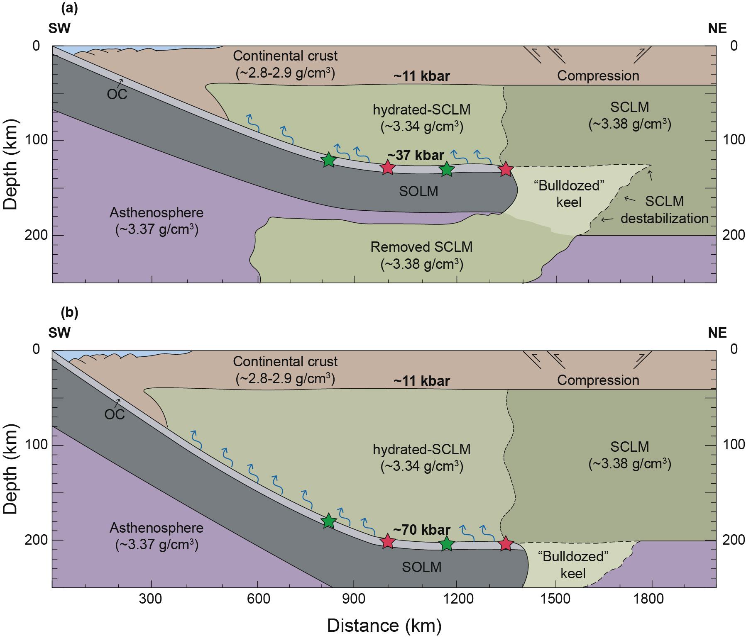
Hernandez-Uribe and Palin (2019)
These models represent the difference in the slab truncating at different depths within the lithosphere
These are concept models
We produced thermal models with the same idea to find the correct inputs that would produce what we see in the Laramide Subduction zone
Hernandez-Uribe and Palin (2019)

Slide 12
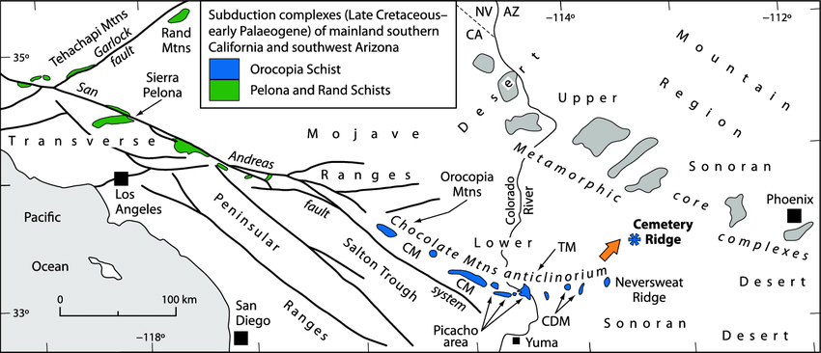
Key Geologic Features explained by models
Water fluxed crustal melts
Laramide Trench
Modified from Jacobson et al. (2013)

Slide 13
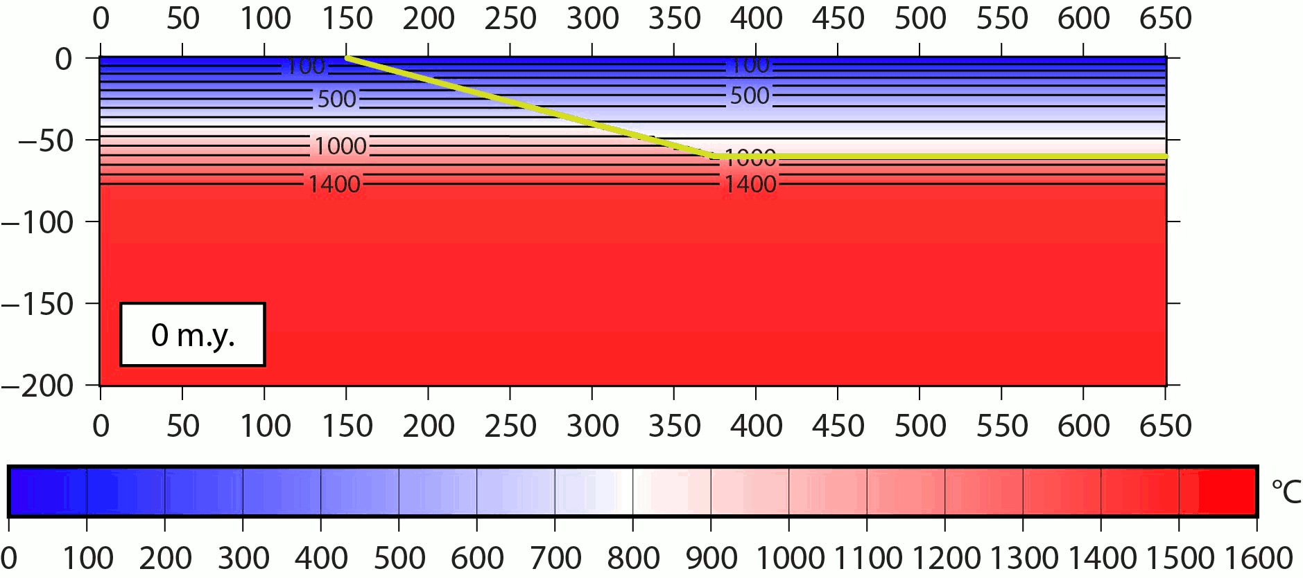
Geotherm of Laramide Subduction over 50my
Frictional coefficient = 0.03
Truncates at 60 km

Slide 14
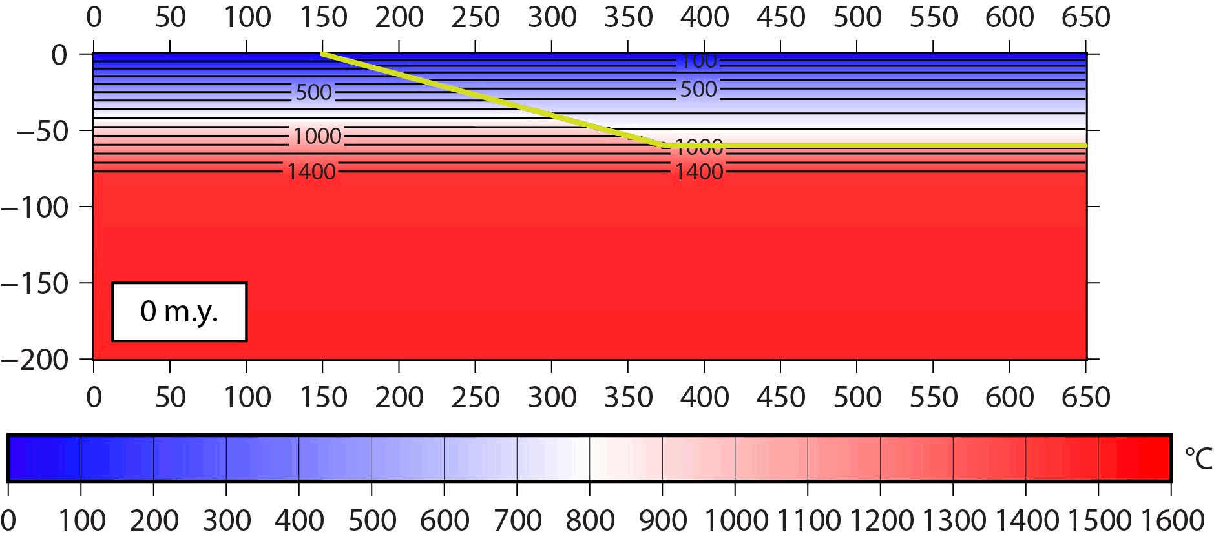
Laramide 2: 60 km Frictional coefficient 0.2

Slide 15
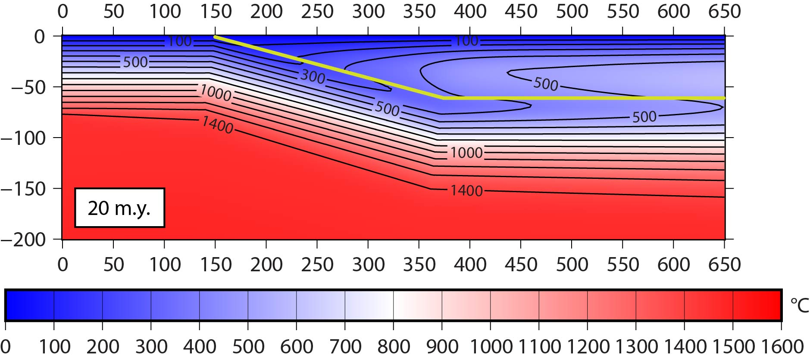

Lar 1 vs Lar 2
km
km

Slide 16
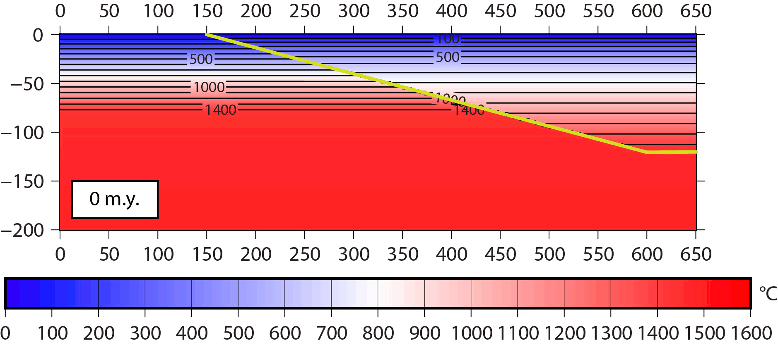
Laramide 3: Truncates at120 km Frictional Coefficient 0.03

Slide 17
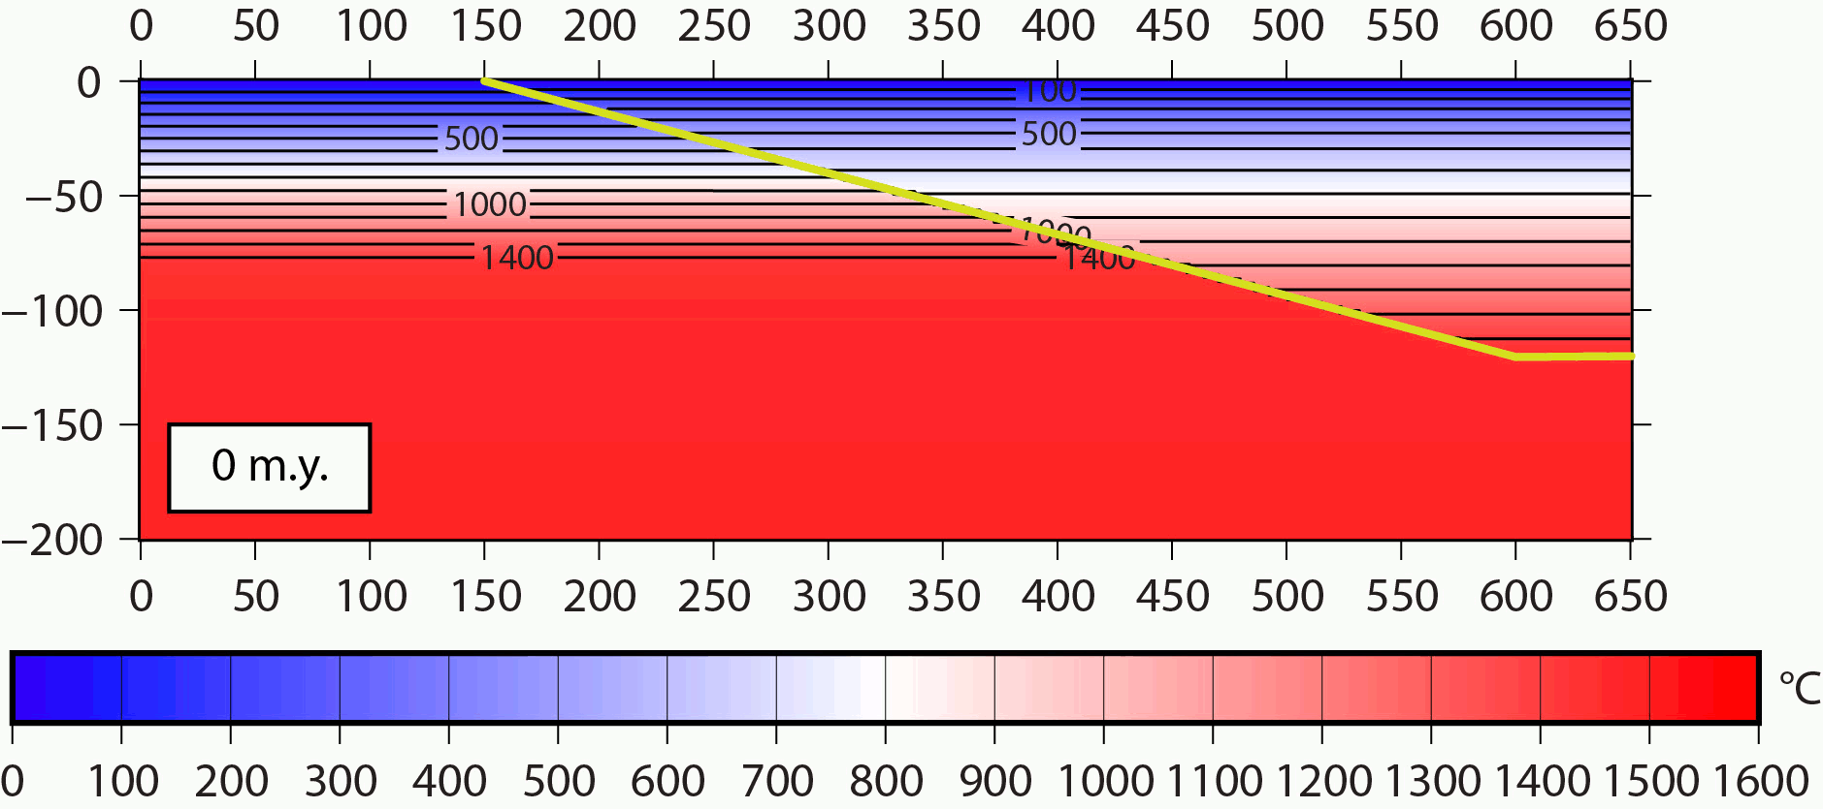
Laramide 4: 120 km Frictional coefficient 0.2

Slide 18
Laramide 5: 300 km depth, Frictional Coefficient 0.03

Slide 19
Laramide 6: 300 km depth, frictional coefficient 0.2
Fault bottoms out at 200km

Slide 20
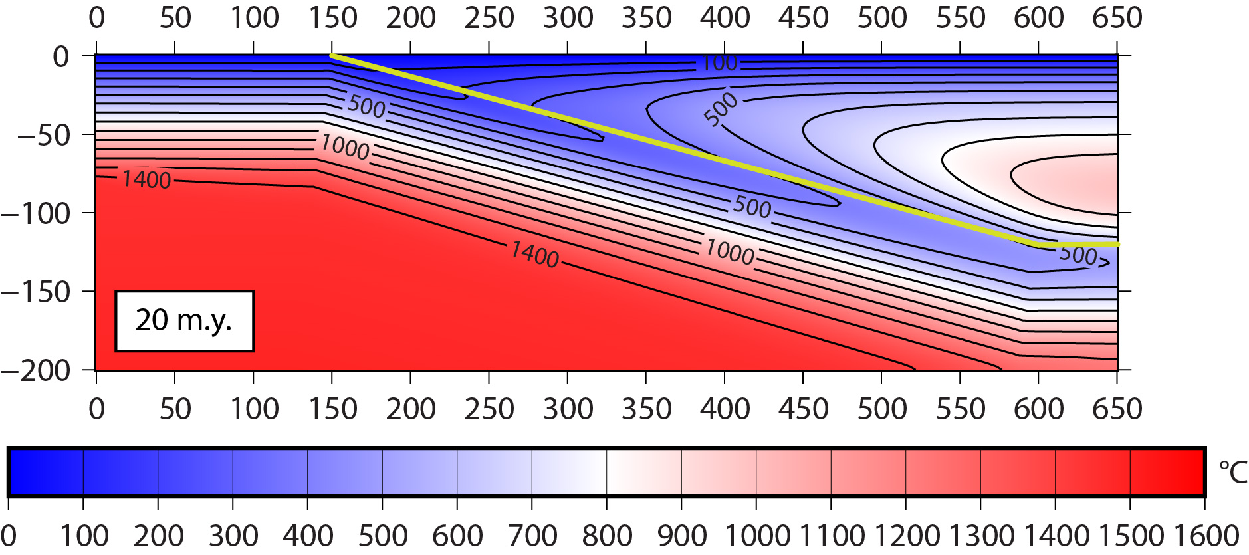

All 4 Models side by side at 20my
Laramide 1
Laramide 2
Laramide 3
Laramide 4

Slide 21
Key Geologic Features explained by models
Water fluxed crustal melts
Laramide Trench
Modified from Jacobson et al. (2013)

Slide 22
Works cited
Axen, Gary J., et al. “Basal Continental Mantle Lithosphere Displaced by Flat-Slab Subduction.” Nature News, Nature Publishing Group, 26 Nov. 2018.
Behr, W.M., and D. Smith. “Structural Geology Projects.” Jackson School of Geosciences, Behr Research Group, 2013.
Dumitru et al., “Refrigeration of the western Cordilleran lithosphere during Laramide shallow-angle subduction.” Geology. The Geological Society of America, 1991.
“Discover Subduction Zones.” Discover Our Earth, Cornell University, NSF, Museum of the Earth. 2020
English, Joseph M., et al. “Thermal Modelling of the Laramide Orogeny: Testing the Flat-Slab Subduction Hypothesis.” Earth and Planetary Science Letters, Elsevier, 26 Aug. 2003.
Hernández-Uribe, David, and Richard M. Palin. “Catastrophic Shear-Removal of Subcontinental Lithospheric Mantle beneath the Colorado Plateau by the Subducted Farallon Slab.” Scientific Reports, Nature, 31 May 2019.
Jacobson, Carl & Haxel, Gordon & Wittke, James & Hourigan, J.K. & Grove, Marty. (2013). Significance of Newly Discovered Subduction Complex, Including Partially Serpentinized Mantle Peridotite, Southwest Arizona.

Slide 23

Questions?

Slide 24
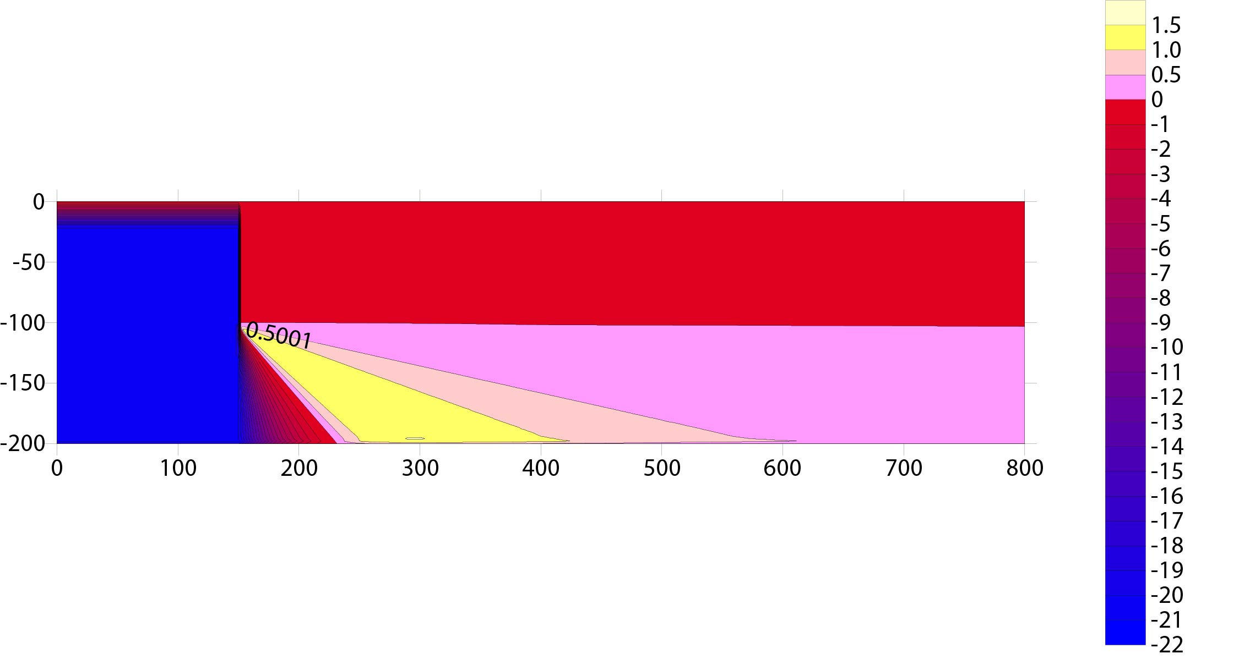
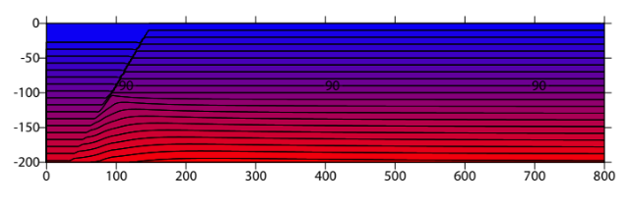
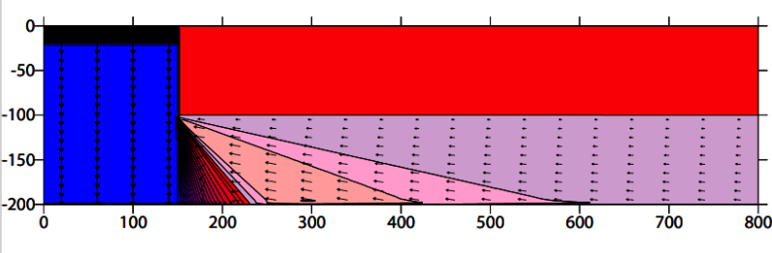
Geology of the Colorado Plateau Fault and a Proposal on why we have volcanism in the san Francisco Field
Here is where the text goes

